Slide 1

Govt Job Pedia
Team Ambitious

Slide 2

Problem Scenario
Every ministry or government organization has its own recruitment board
Each recruitment board has its own way of announcing vacancies
This leads to multiple channels in order to check for jobs in Government Sector

Slide 3
Our Solution (For Users – App)
This app is a one stop solution, providing a unified portal
Ministries and Government agencies would have a standard way to announce job vacancies
User can look for all the relevant jobs at a single place

Slide 4
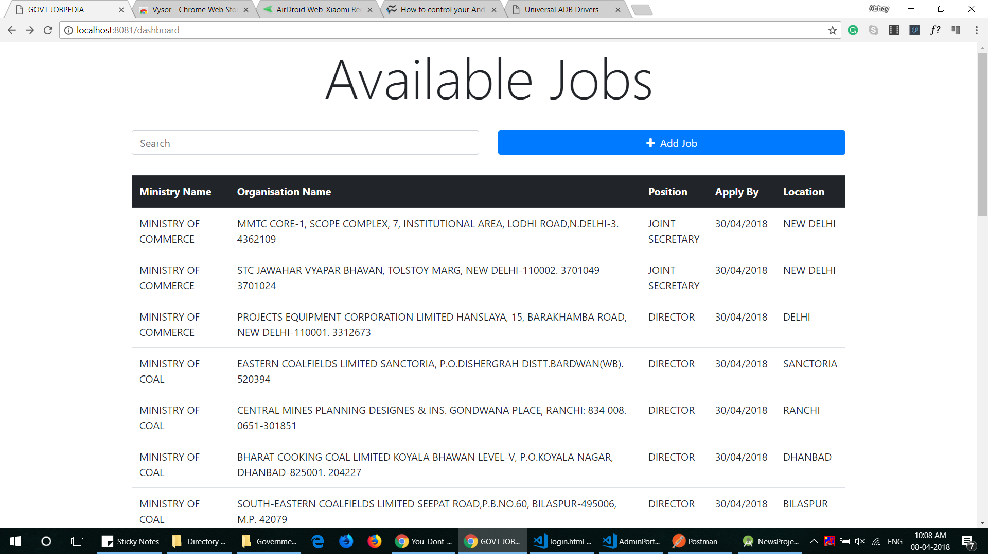
Our Solution (For Govt –Admin Portal)
View a list of all available jobs
Post more jobs for applications
Authentication feature

Slide 5
Future Scope
Multilingual support
Contact support
Notifications of new jobs
Online application configuration
Upload required documents
Integration with other portals for strengthening of in-demand skills

